Slide 1

Intro to GIT
Konkuk University, Department of Computer Science/Software
Jason. HW. Kang

Slide 2
Contents
1. What is git?
2. How it works?
3. Installing git on Windows
4. Installing git on macOS
5. Installing git on Ubuntu/Linux

Slide 3
What is git?
When you work alone..
Have you ever felt an anger because your file didn’t saved at all?
When you work with others…
Have you ever experienced you wrote something, but its overwritten by other colleague’s work?

Slide 4
What is git?
From Dictionary and theoretical meaning:
“Distributed Version Control System”

Slide 5

How it works? (The brief one)
”Distributed” Shape
Top(commit/push)- Down(HEAD Reset) Shape-Process
Interactive/communicative Structure

Slide 6


How it works? (The substances)
Server
Local Repository

Slide 7
How it works? (Repository: What is it?)
Contains..
1. Your designated Files
2. Git information(head, refs, remote, etc..)
3. The “Log”
Repository
Repository ≈ ”Workplace”

Slide 8
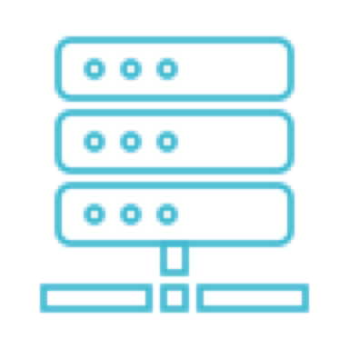
How it works? (History/Commit: What is it?)
1. A history of your modification
2. Both exists on Server/Local Repository
3. A “Changes” would be the one
Log/History/Commit

Slide 9
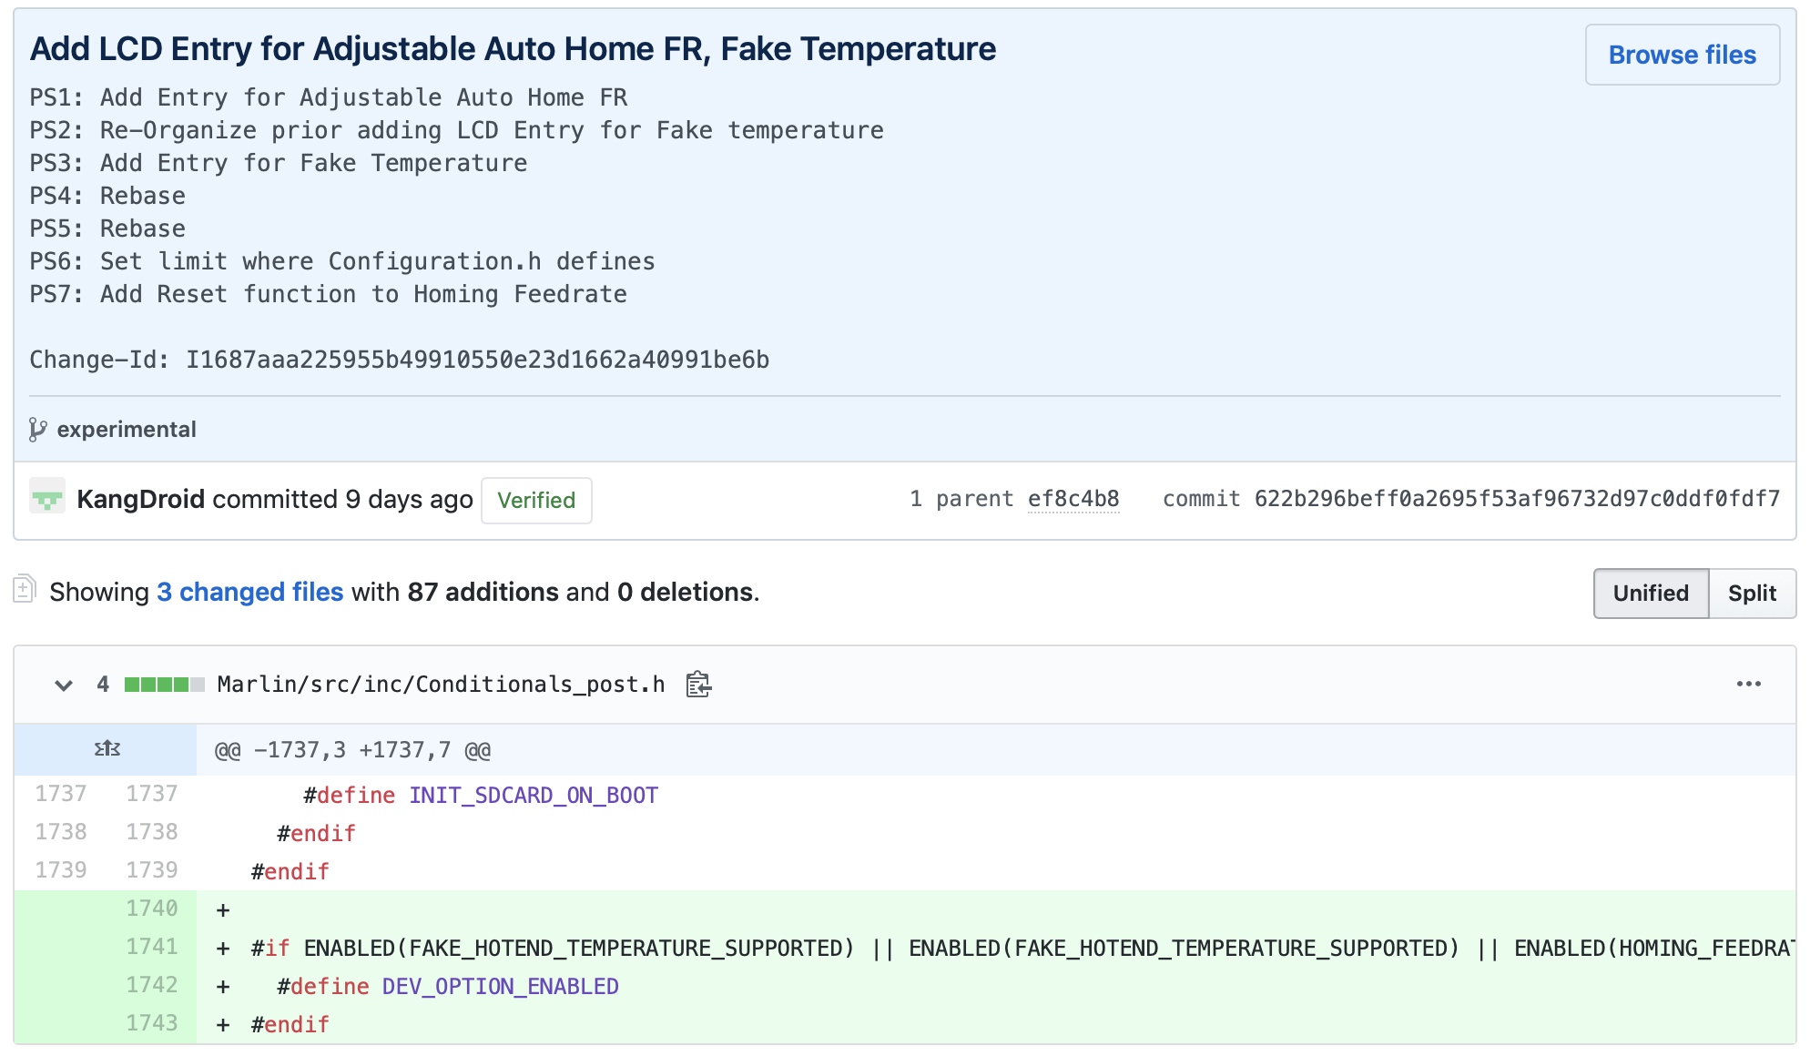
How it works? (History/Commit: What is it?)
Something like this…

Slide 10


How it works? (Push/Pull: Push)
Server Repo
Communication
Local Repo

Slide 11
How it works? (Push/Pull: Push)
Clone
Empty(None/Null)

Slide 12
How it works? (Clone/Cloning)
1. Get all info, whole data to local device.
2. So cloning mostly equals to “Download Repository”
3. Makes a copy of remote repository to local device
Clone
Empty(None/Null)

Slide 13
How it works? (Push/Pull: Push)
Push

Slide 14
How it works? (Push/Pull: Push)
1. Upload changed git data
2. Includes file changes
3. Applying update to remote repository(from local repository)
Push

Slide 15
How it works? (Push/Pull: Pull)
Pull

Slide 16
How it works? (Push/Pull: Pull)
1. Fetch remote repository
2. Update Local repository(from Remote repository)
3. It is completely differ from Cloning
Pull

